Slide 1
Multiple Linear Regression
CME 4416 Introduction to Data Mining

Slide 2
Introduction
Multiple linear regression attempts to model the relationship between two or more explanatory variables and a response variable by fitting a linear equation to observed data. Every value of the independent variable x is associated with a value of the dependent variable

Slide 3
Probabilistic Model
: the observed value of the random variable(r.v.)
depends on fixed predictor values
,i=1,2,3,…,n
unknown model parameters
n is the number of observations.
i.i.d
~ N (0, )

Slide 4


Fitting the model
LS provides estimates of the unknown model parameters,
which minimizes Q
(j=1,2,…,k)

Slide 5
Goodness of Fit of the Model
Residuals
are the fitted values
An overall measure of the goodness of fit
Error sum of squares (SSE):
total sum of squares (SST):
regression sum of squares (SSR):
Notes:
SST is the SSE obtained when fitting the model Yi = B0 + ei, which ignores all the x’s
R^2 = 0.5 means 50% of the variation in y is accounted for by x, in this case, all x’s

Slide 6
Multiple Regression Model
In Matrix Notation

Slide 7
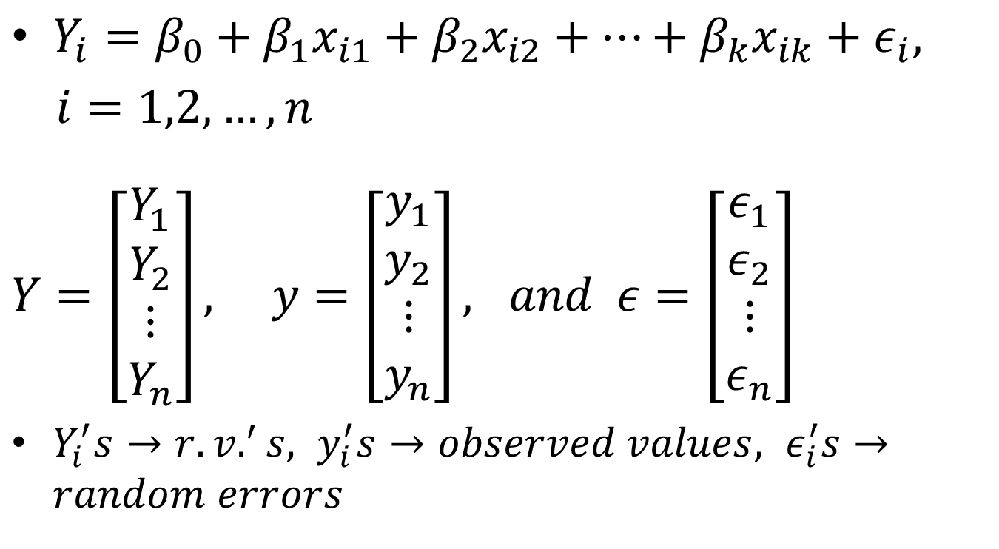
1. Transform the Formulas to Matrix Notation

Slide 8
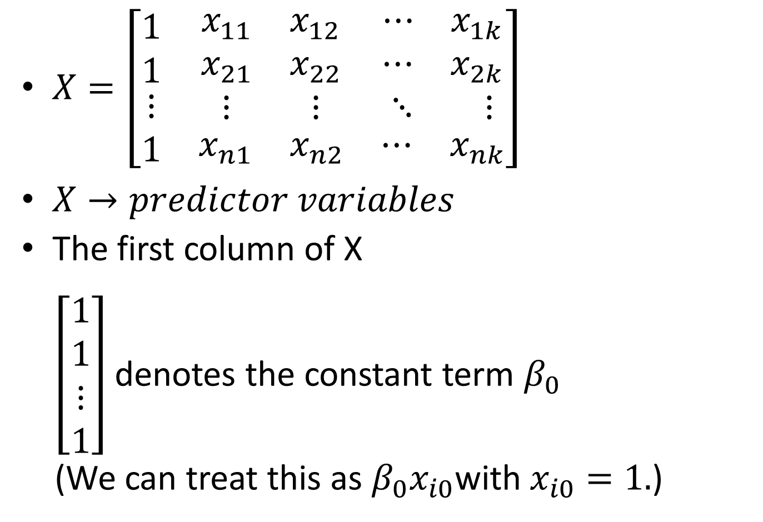
$X=\left[\begin{matrix}\begin{aligned}1 \\ 1\end{aligned} & \begin{aligned}\begin{matrix}x_{11} & x_{12}\end{matrix} \\ \begin{matrix}x_{21} & x_{22}\end{matrix}\end{aligned} & \begin{aligned}\begin{matrix}⋯ & x_{1k}\end{matrix} \\ \begin{matrix}⋯ & x_{2k}\end{matrix}\end{aligned} \\ ⋮ & \begin{matrix}⋮ & ⋮\end{matrix} & \begin{matrix}⋱ & ⋮\end{matrix} \\ 1 & \begin{matrix}x_{n1} & x_{n2}\end{matrix} & \begin{matrix}⋯ & x_{nk}\end{matrix}\end{matrix}\right]$
$X→predictor variables$
The first column of X
$\left[\begin{aligned}1 \\ 1 \\ ⋮ \\ 1\end{aligned}\right]$denotes the constant term $β_{0}$
(We can treat this as $β_{0}x_{i0}$with$x_{i0}=1.$)

Slide 9
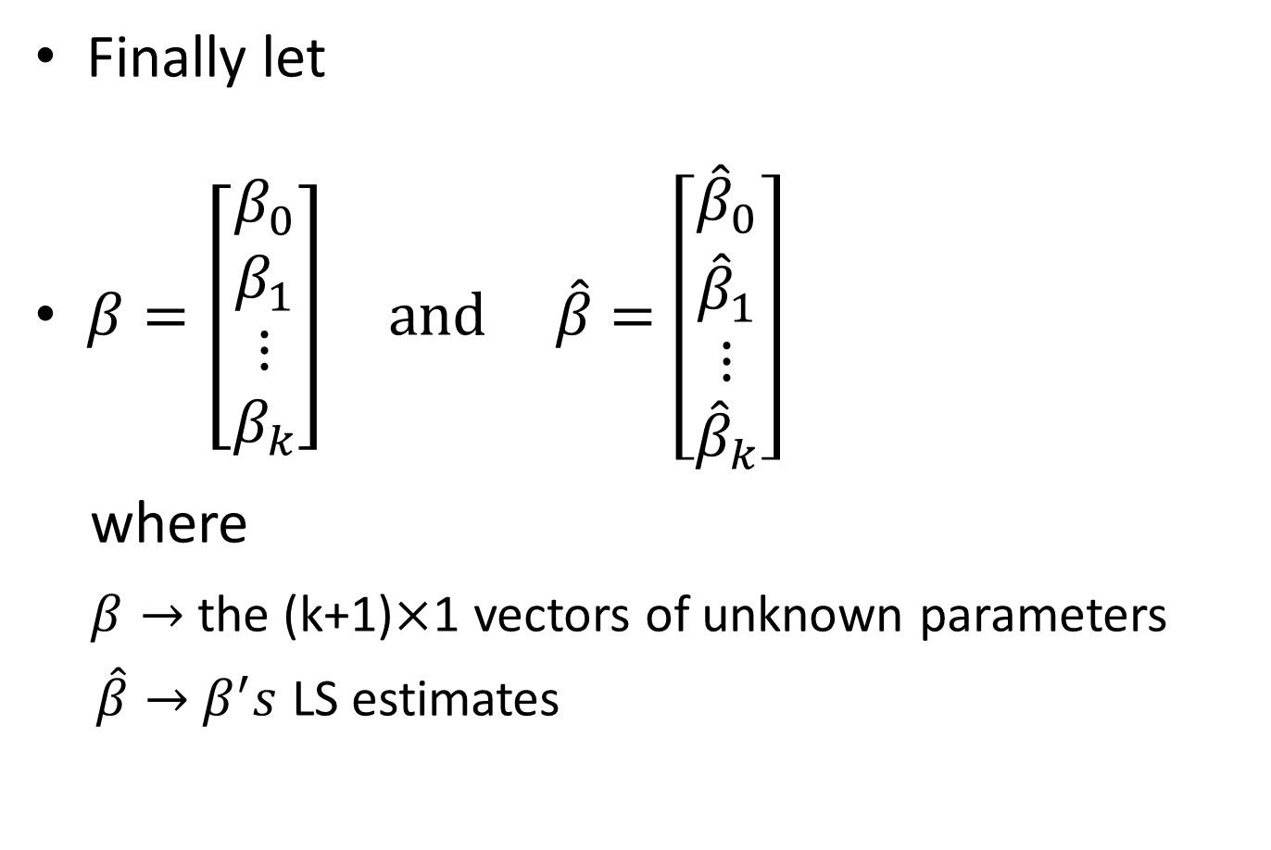
Finally let
$β=\left[\begin{aligned}β_{0} \\ β_{1} \\ ⋮ \\ β_{k}\end{aligned}\right] and \hat{β}=\left[\begin{aligned}{\hat{β}}_{0} \\ {\hat{β}}_{1} \\ ⋮ \\ {\hat{β}}_{k}\end{aligned}\right]$
where
$β→$ the (k+1)$×$1 vectors of unknown parameters
$\hat{β}→$ $β^{′}s$ LS estimates

Slide 10
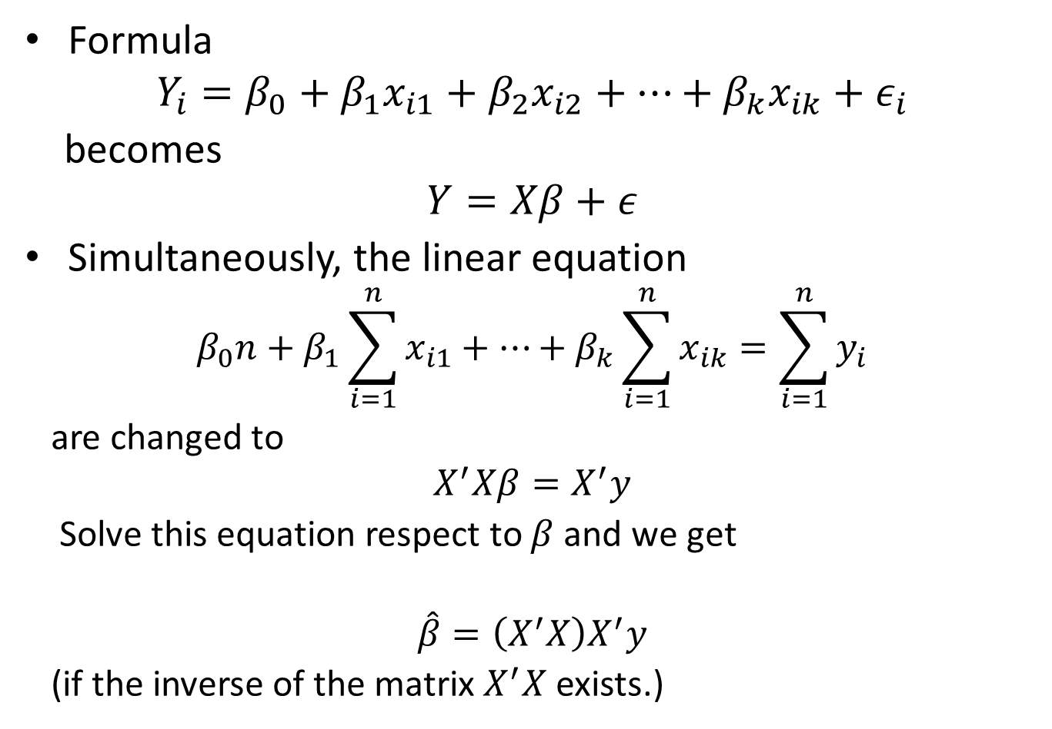
Formula
$$Y_{i}=β_{0}+β_{1}x_{i1}+β_{2}x_{i2}+⋯+β_{k}x_{ik}+ε_{i}$$
becomes
$$Y=Xβ+ε$$
Simultaneously, the linear equation
$$β_{0}n+β_{1}\sum_{i=1}^{n}{x_{i1}}+…+β_{k}\sum_{i=1}^{n}{x_{ik}}=\sum_{i=1}^{n}{y_{i}}$$
are changed to
$$X^{′}Xβ=X^{′}y$$
Solve this equation respect to $β$ and we get
$$\hat{β}=\left(X^{′}X\right)X^{′}y$$
(if the inverse of the matrix $X^{′}X$ exists.)
-1

Slide 11
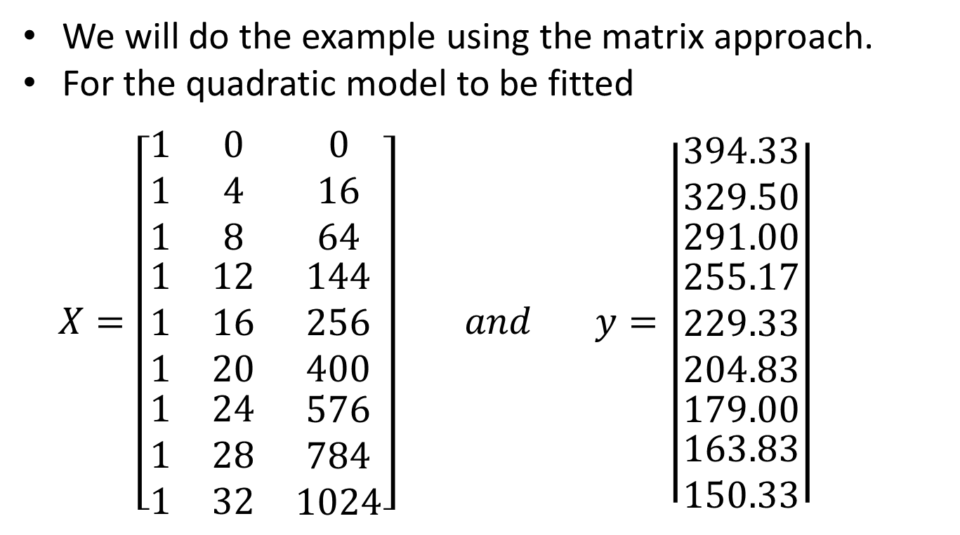
Example (Tire Wear Data: Quadratic Fit Using Hand Calculations)
We will do the example using the matrix approach.
For the quadratic model to be fitted
$X=\left[\begin{matrix}\begin{matrix}1 \\ 1 \\ 1\end{matrix} & \begin{matrix}0 \\ 4 \\ 8\end{matrix} & \begin{matrix}0 \\ 16 \\ 64\end{matrix} \\ \begin{matrix}1 \\ 1 \\ 1\end{matrix} & \begin{matrix}12 \\ 16 \\ 20\end{matrix} & \begin{matrix}144 \\ 256 \\ 400\end{matrix} \\ \begin{matrix}1 \\ 1 \\ 1\end{matrix} & \begin{matrix}24 \\ 28 \\ 32\end{matrix} & \begin{matrix}576 \\ 784 \\ 1024\end{matrix}\end{matrix}\right] and y=\left|\begin{matrix}\begin{matrix}394.33 \\ 329.50 \\ \begin{matrix}291.00 \\ \begin{matrix}255.17 \\ 229.33 \\ 204.83\end{matrix} \\ 179.00\end{matrix}\end{matrix} \\ 163.83 \\ 150.33\end{matrix}\right|$

Slide 12
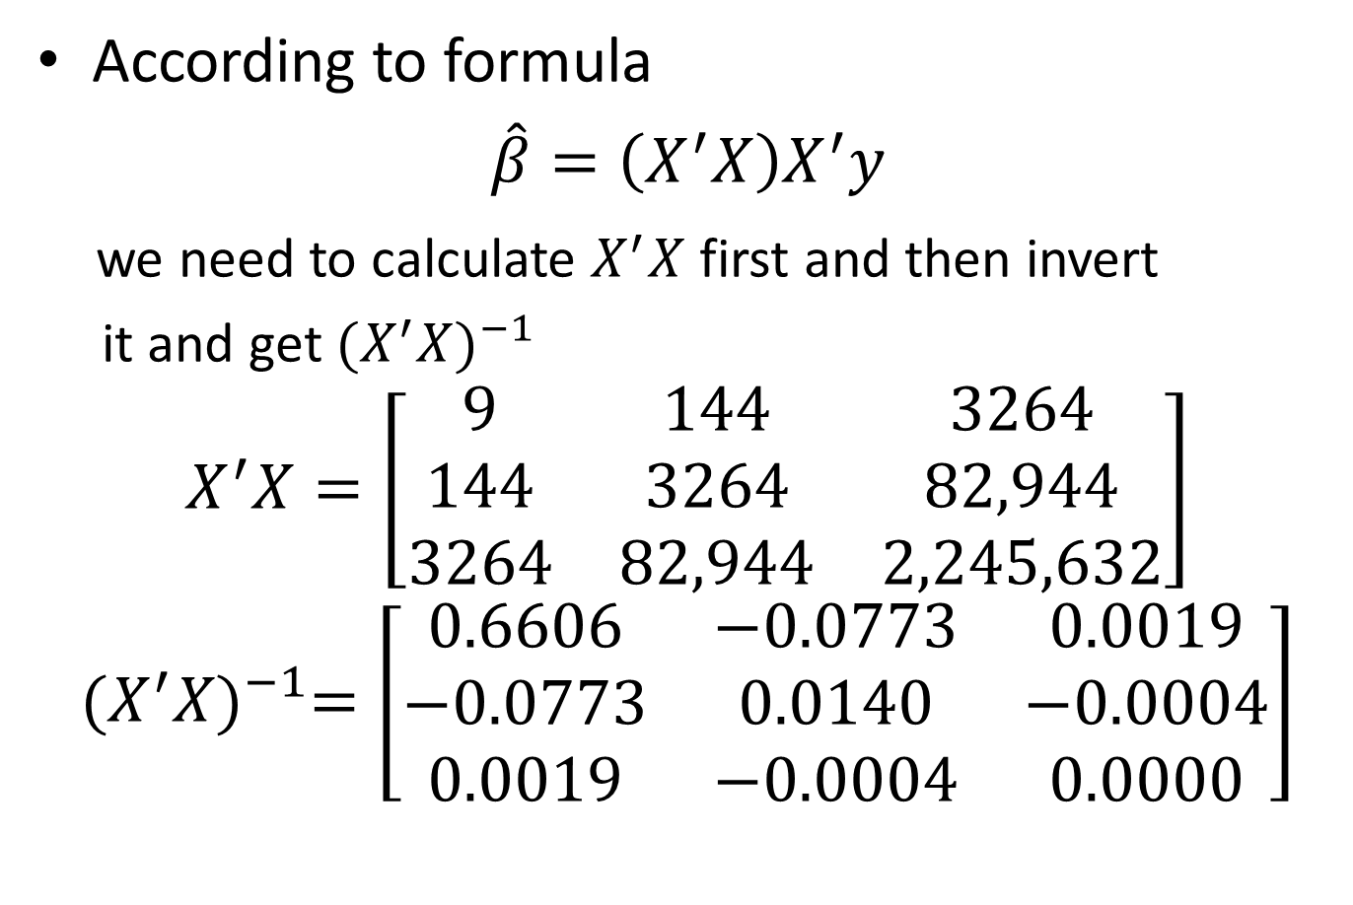
According to formula
$$\hat{β}=\left(X^{′}X\right)X^{′}y$$
we need to calculate $X^{′}X$ first and then invert
it and get ${(X^{′}X)}^{−1}$
$$X^{′}X=\left[\begin{matrix}9 & 144 & 3264 \\ 144 & 3264 & 82,944 \\ 3264 & 82,944 & 2,245,632\end{matrix}\right]$$
$${(X^{′}X)}^{−1}=\left[\begin{matrix}0.6606 & −0.0773 & 0.0019 \\ −0.0773 & 0.0140 & −0.0004 \\ 0.0019 & −0.0004 & 0.0000\end{matrix}\right]$$
-1

Slide 13
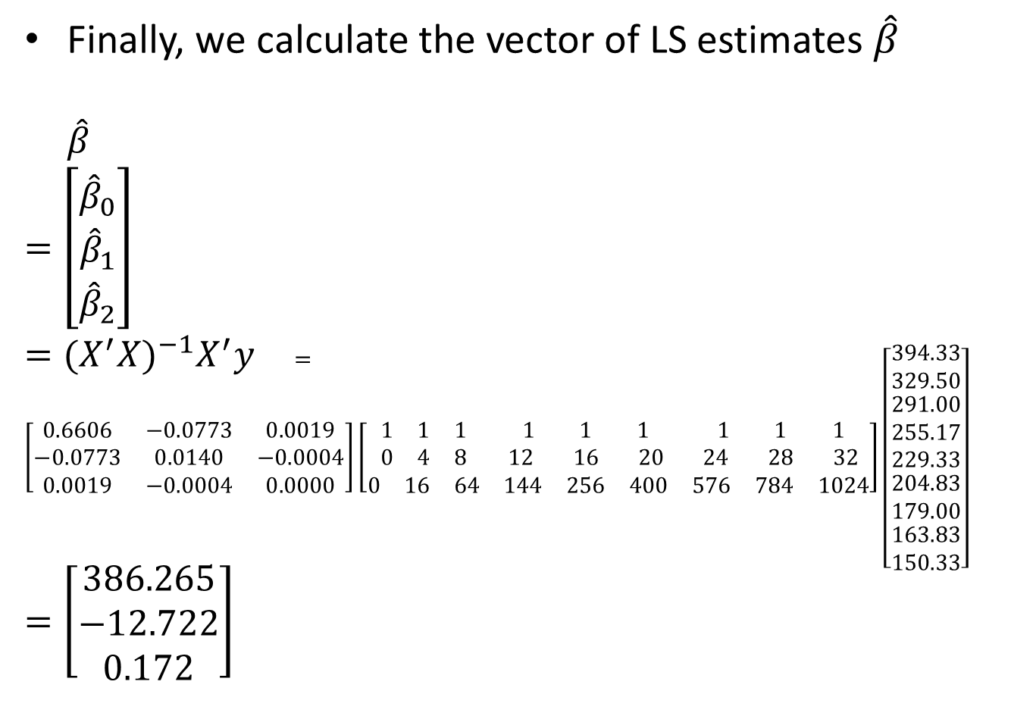
Finally, we calculate the vector of LS estimates $\hat{β}$
$\hat{β}$
$$=\left[\begin{matrix}{\hat{β}}_{0} \\ {\hat{β}}_{1} \\ {\hat{β}}_{2}\end{matrix}\right]$$
$={(X^{′}X)}^{−1}X^{′}y$ $=\left[\begin{matrix}0.6606 & −0.0773 & 0.0019 \\ −0.0773 & 0.0140 & −0.0004 \\ 0.0019 & −0.0004 & 0.0000\end{matrix}\right]\left[\begin{matrix}\begin{matrix}1 & 1 & 1\end{matrix} & \begin{matrix}1 & 1 & 1\end{matrix} & \begin{matrix}1 & 1 & 1\end{matrix} \\ \begin{matrix}0 & 4 & 8\end{matrix} & \begin{matrix}12 & 16 & 20\end{matrix} & \begin{matrix}24 & 28 & 32\end{matrix} \\ \begin{matrix}0 & 16 & 64\end{matrix} & \begin{matrix}144 & 256 & 400\end{matrix} & \begin{matrix}576 & 784 & 1024\end{matrix}\end{matrix}\right]\left[\begin{matrix}394.33 \\ 329.50 \\ \begin{matrix}\begin{matrix}\begin{matrix}291.00 \\ 255.17 \\ 229.33\end{matrix} \\ 204.83 \\ 179.00\end{matrix} \\ 163.83 \\ 150.33\end{matrix}\end{matrix}\right]$
$$=\left[\begin{matrix}386.265 \\ −12.722 \\ 0.172\end{matrix}\right]$$

Slide 14

Therefore, the LS quadratic model is
$$\hat{y}=386.265−12.772x+0.172x^{2}.$$

Slide 15
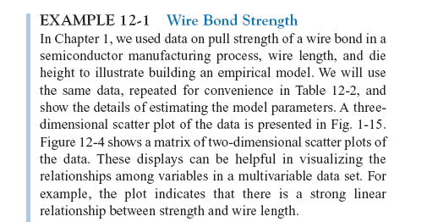
Example 2

Slide 16
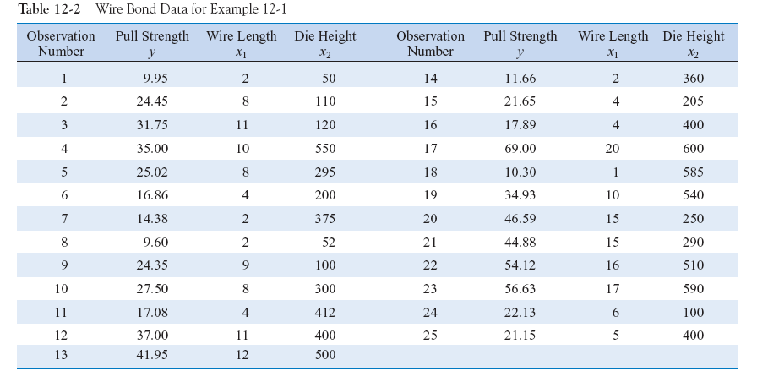
Example 2

Slide 17
Matrix Approach to Multiple Linear Regression
Suppose the model relating the regressors to the response is
In matrix notation this model can be written as

Slide 18
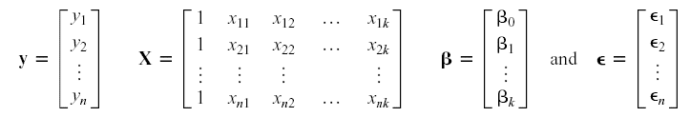
Matrix Approach to Multiple Linear Regression
where

Slide 19

Matrix Approach to Multiple Linear Regression
We wish to find the vector of least squares estimators that minimizes:
The resulting least squares estimate is

Slide 20
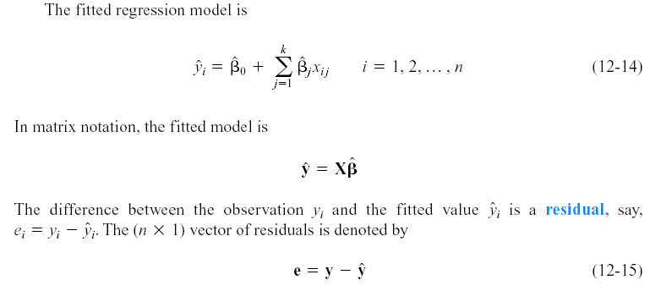
Matrix Approach to Multiple Linear Regression

Slide 21
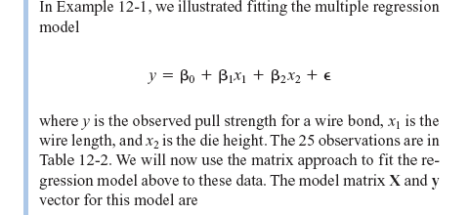
Example 12-2

Slide 22
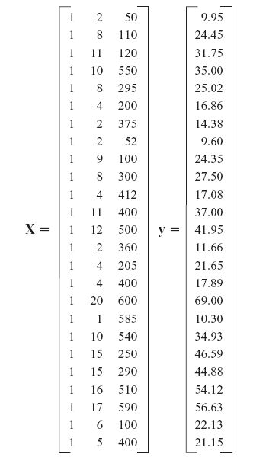
Example 2

Slide 23
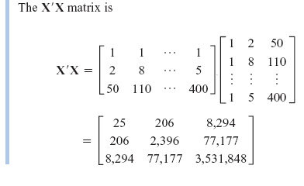
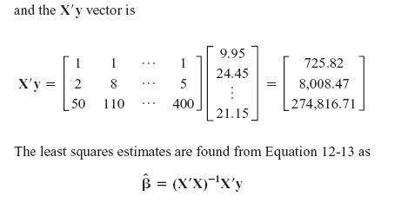
Example 2

Slide 24
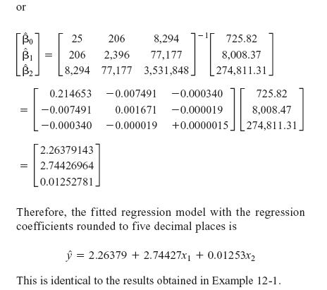
Example 2

Slide 25
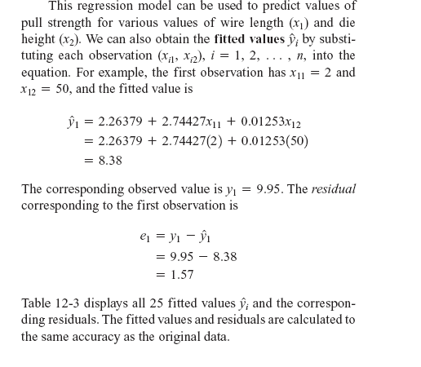
12-1: Multiple Linear Regression Models
Example 2

Slide 26
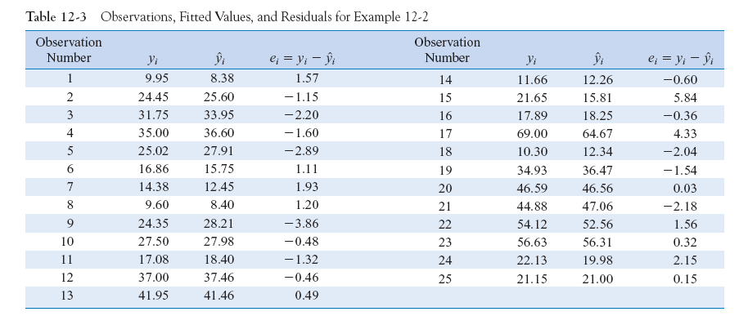
Example 2

Slide 27
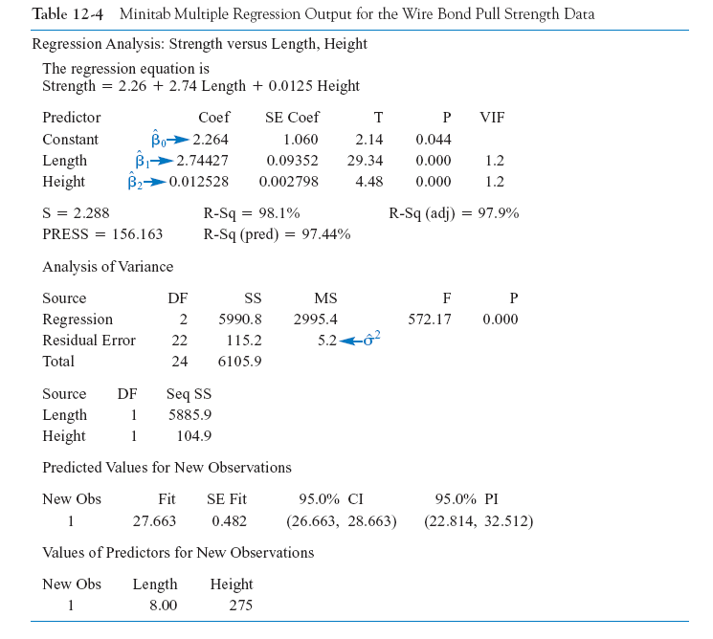

Slide 28
Acknowledgement
Ghassan Elias
California State University

